Slide 1
Explainable Reasoning over Knowledge Graphs for Recommendation
Xiang Wang, Dingxian Wang, Canran Xu, Xiangnan He, Yixin Cao, and Tat-Seng Chua. 2019. Explainable Reasoning over Knowledge Graphs for Recommendation. In AAAI

Slide 2


Knowledge Graph
Original KG
E (nodes), R (edges), KG = {(h,r,t)|h,t∈E, r∈R}
user-item data
bipartite graph,
M and N are the number of users and items
interaction: τ =(u, interact, i), interact is a pre-defined relation
KG
merge the item set and the entity set through string matching: I ∈ E.
KG = {(h,r,t)|h,t∈E’, r∈R’}, E’ = E∪U, R’ = R ∪{interact}

Slide 3
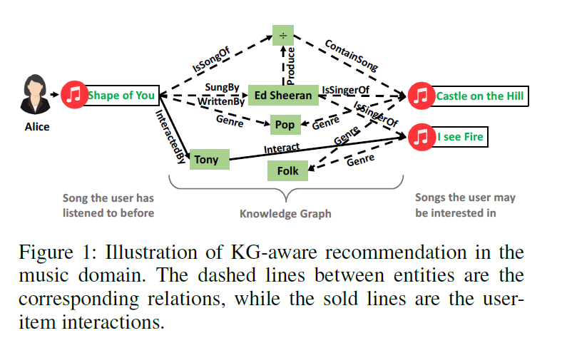
Explainable Reasoning over Knowledge Graphs for Recommendation
Goal: infer user u preference on item i
Input: paths connects u and i
Output: score

Slide 4

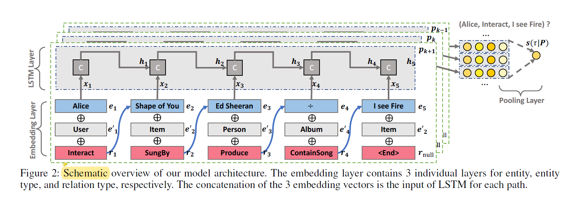
Model
Embedding Layer, LSTM Layer, Pooling Layer

Slide 5
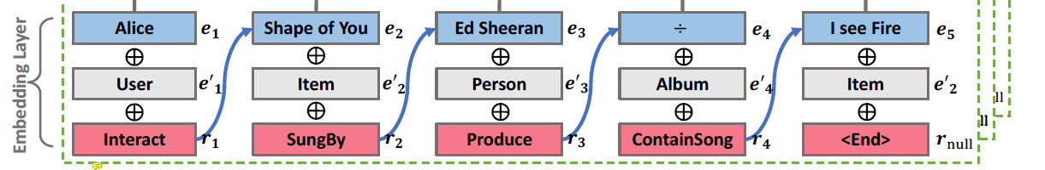
Model: Embedding Layer:
three types of IDs
entity value
entity type
relation: same entity-entity with different relations is important

Slide 6

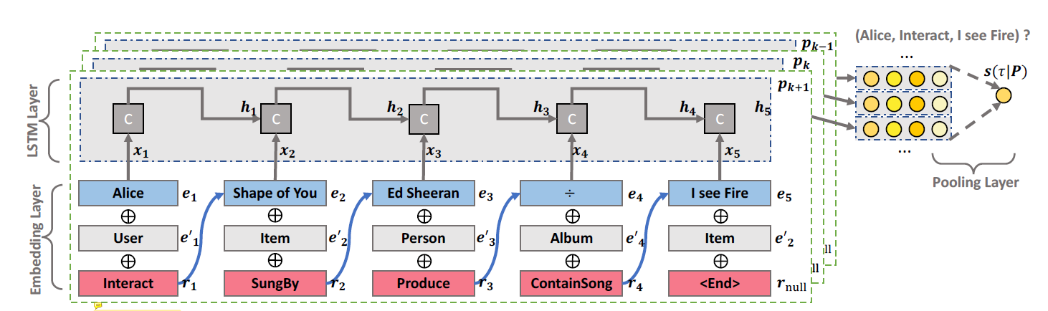
Model: LSTM Layer
Input:
Output: last state h_{L} is capable of representing the whole path
two fully-connected layers to get the predictive score

Slide 7
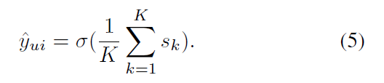
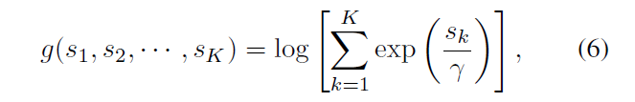
Model: Weighted Pooling Layer
average
weighted pooling operation

Slide 8
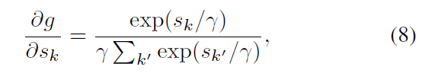
Model
γ is the hyper-parameter to control each exponential weight
Distinguishing the path by the gradient:
which is proportional to the score of each path during the back-propagation step.
r → 0, max-pooling
r → ∞, mean-pooling

Slide 9
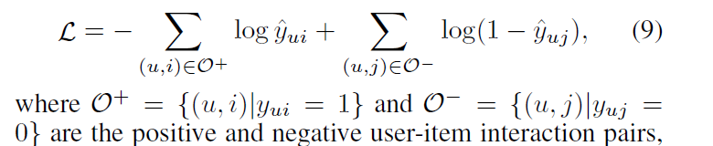
Model
Learning
treat the recommender learning task as a binary classification problem, interaction 1, otherwise 0.
negative log-likelihood objective function:

Slide 10
Experiments: Dataset Description
movie recommendation
MovieLens-1M: offers the user-item interaction data
IMDb datasets: serves as original KG
music recommendation
KKBox benchmark dataset
Beyond the user-item interaction data, this dataset contains the descriptions of music like singer, songwriter, and genre.

Slide 11
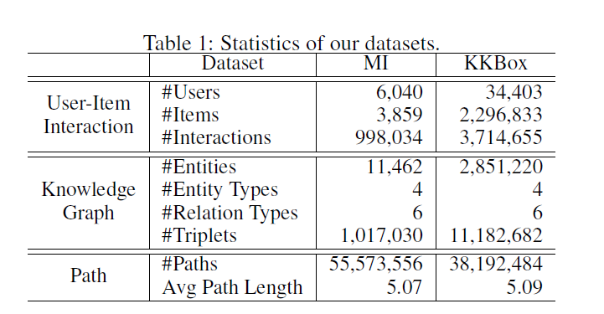
Experiments: Dataset Description

Slide 12
Experiments: Dataset Description
positive: a user rates a movie or has an interaction with a song.
negative: for each positive user-item pair, we conducted four items that the user has not interacted with.
test stage: the ratio between positive and negative interactions is set as 1 : 100.

Slide 13
Experiments: Experimental Settings
Evaluation Metrics: top-K and preference ranking
hit@K considers whether the relevant items are retrieved within the top K positions of the recommendation list.
ndcg@K measures the relative orders among positive and negative items within the top K of the ranking list.
We report the average metrics at K = {1, 2, … , 15} of all instances in the test set.
Baselines
MF, NFM, CKE, FMG
Parameter Settings

Slide 14
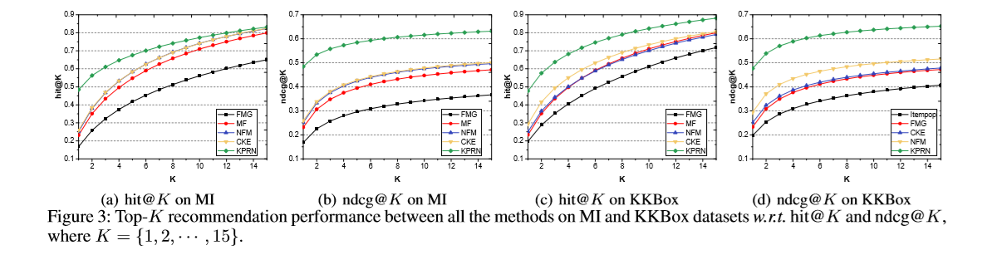
Experiments: Performance Comparison

Slide 15
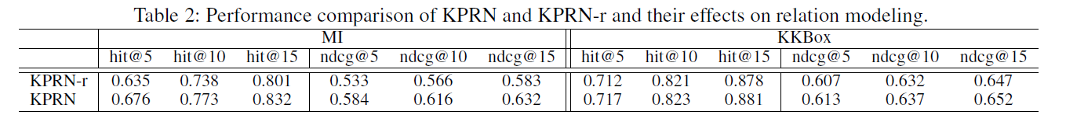
Experiments: Effects of Relation Modeling
We consider one variant of KPRN without the relation modeling, termed as KPRN-r.

Slide 16
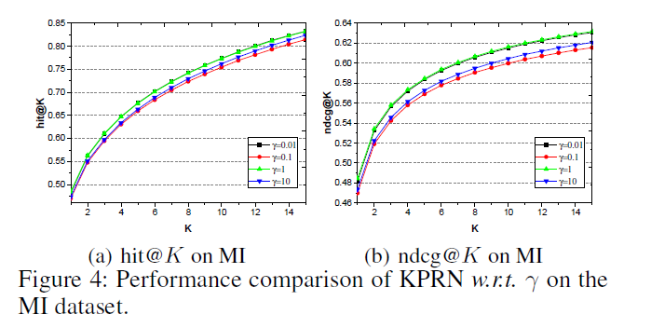
Experiments: Effects of Weighted Pooling

Slide 17
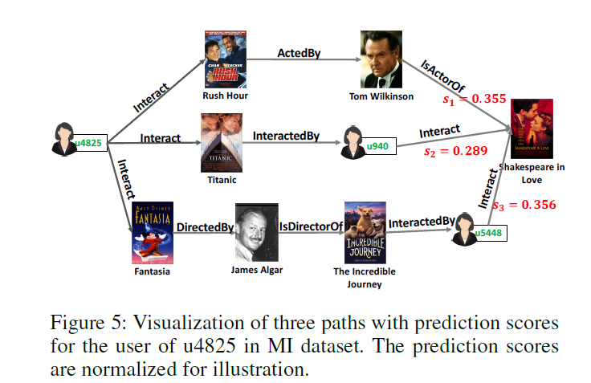
Experiments: Case Studies
Collaborative filtering effect plays a pivotal rule (two path)
different paths describe the user-item connectivity from dissimilar angles
path1: same actor
path2: similar to Titanic
path3:

Slide 19
Path Extraction
All paths: labor intensive and infeasible
Sufficient paths:
truncating all paths at a certain length (<6)
disregarding remote connections
Notes:
disregarding: 不理会，不顾

Slide 20
Abstract
Incorporating knowledge graph into recommender systems
By exploring the interlinks within a knowledge graph, the connectivity between users and items can be discovered as paths, which provide rich and complementary information to user-item interactions.
Such connectivity not only reveals the semantics of entities and relations, but also helps to comprehend a user’s interest.

Slide 21
Abstract
In this paper, we contribute a new model named Knowledge-aware Path Recurrent Network (KPRN) to exploit knowledge graph for recommendation.
Reasoning：sequential dependencies
Explainability：weighted pooling operation to discriminate the strengths of different paths

Slide 22
Introduction
Extra user-item connectivity information derived from KG endows recommender systems the ability of reasoning and explainability.

Slide 23
Introduction: recommendation fashion
Path
meta-path
limitations:
similar entities but different relations
require domain knowledge, fail to automatically uncover and reason on unseen connectivity patterns
Embedding
lacks the reasoning ability, it only considers direct relations between entities.
the representation of user-item connectivity in a implicit way,

Slide 24
Introduction
In terms of reasoning, we expect our method to model the sequential dependencies of entities and sophisticated relations of a path connecting a user-item pair.
In terms of explainability, we would like our method to discriminate the different contributions of different paths, when inferring user interests.

Slide 25
Introduction: KPPN
KPRN not only generates representations for paths by accounting for both entities and relations, but also performs reasoning based on paths to infer user preference.
Process

Slide 26
extract qualified paths between a user-item pair which consists of the related entities and relations
adopt a LSTM network to model the sequential dependencies of entities and relations
a pooling operation is performed to aggregate the representations of paths to obtain prediction signal for the user-item pair

Slide 27
More importantly, the pooling operation is capable of discriminating the contributions of different paths for a prediction, which functions as the attention mechanism.
Owing to such attentive effect, our model can offer path-wise explanations such as Castle on the Hill is recommended since you have listened to Shape of You sung and written by Ed Sheeran.

Slide 28
The contributions of this work are threefold:
We highlight the importance of performing explicit reasoning on KG to better reveal the reasons behind a recommendation.
We propose an end-to-end neural network model to learn path semantics and integrate them into recommendation.
We contribute a dataset to study KG for recommendation by aligning a MovieLens benchmark with IMDB.

Slide 29


KPRN: Background
Original KG
E (nodes), R (edges)
KG = {(h,r,t)|h,t∈E, r∈R}
user-item data
The user-item interaction data is usually presented as a bipartite graph.
M and N are the number of users and items
interaction: τ =(u, interact, i), interact is a pre-defined relation
We merge the item set and the entity set through string matching: I ∈ E.
KG = {(h,r,t)|h,t∈E’, r∈R’}, E’ = E∪U, R’ = R ∪{interact}
$$U=\{ut\}\sum_{t=1}^{M}{ }$$
$$I=\{it\}\sum_{t=1}^{N}{ }$$

Slide 30
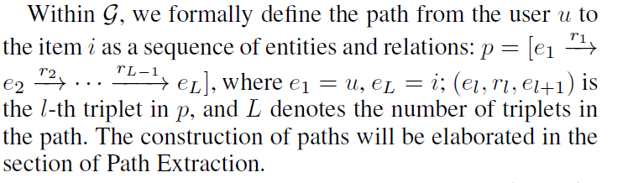
KPRN: Preference Inference via Paths
The triplets in the KG clearly describe direct or indirect (i.e. multiple-step) relational properties of items, which shall constitute one or several paths between the given user and item pair. We explore these paths in order to achieve comprehensively reasoning and understanding for recommendation.

Slide 31
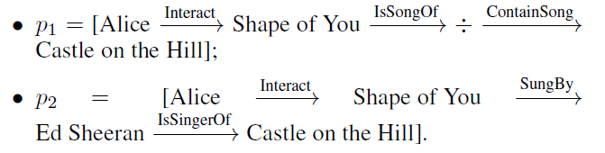

KPRN: Preference Inference via Paths
Behavior paths: user Alice listen to Castle on the Hill
p1: similar album ÷
p2: similar singer ES
p3: collaborative filtering
Notes:
collaborative filtering (CF) effect: similar users tend to have similar preferences

Slide 32


KPRN: Task Definition
user u, item i, a set of paths P(u, i) = {p₁, p₂, … , p_{K}} connecting u and i.
goal is to estimate the interaction by:
f denotes underlying model with parameters Θ
present the predicted score for the user-item interaction

Slide 33
KPRN: Modeling
input: a set of paths of each user-item pair
output: score, possible interaction between user and item
three key components
embedding layer to project three types of IDs information: the entity, entity type, and the relation pointing to the next node into a latent space
LSTM layer that encodes the elements sequentially with the goal of capturing the compositional semantics of entities conditioned on relations
pooling layer to combine multiple paths and output the final score of the given user interacting the target item

Slide 34
KPRN: Embedding Layer
entity: value and type
relation: same entity-entity with different relations is important

Slide 35
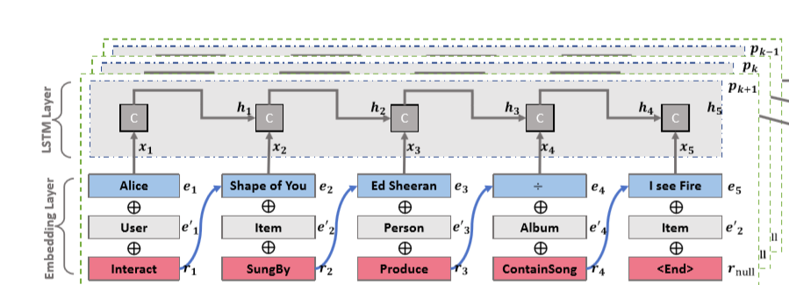
KPRN: LSTM Layer
Taking advantages of the memory state, the last state h_{L} is capable of representing the whole path.

Slide 36
KPRN: LSTM Layer
two fully-connected layers are adopted to project the final state into the predictive score for output

Slide 37
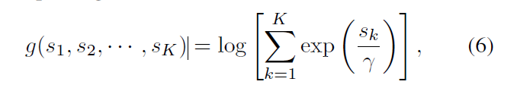

KPRN: Weighted Pooling Layer
A user-item entity pair usually has a set of paths
Let S = { s₁, s₂, …, s_{K}} be the predictive scores for K paths
The final prediction could be the average of the scores of all paths
we design a weighted pooling operation to aggregate scores of all paths

Slide 38
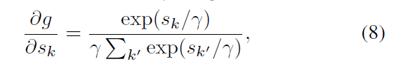
KPRN: Weighted Pooling Layer
Such pooling is capable of distinguishing the path importance, which is attributed by the gradient:
r → 0, max-pooling
r → ∞, mean-pooling

Slide 39
KPRN: Learning
treat the recommender learning task as a binary classification problem, interaction 1, otherwise 0.
objective function:

Slide 40
Experiments: Research Questions
RQ1: Compared with the state-of-the-art KG-enhanced methods, how does our method perform?
RQ2: How does the multi-step path modeling (e.g., the incorporation of both entity and relation types) affect KPRN?
RQ3: Can our proposed method reason on paths to infer user preferences towards items?

Slide 41
Experiments: Dataset Description
movie recommendation
MovieLens-1M: offers the user-item interaction data
IMDb datasets: serves as original KG
music recommendation
KKBox benchmark dataset
Beyond the user-item interaction data, this dataset contains the descriptions of music like singer, songwriter, and genre.

Slide 42
Experiments: Dataset Description

Slide 43
Experiments: Dataset Description
Following previous efforts (Yu et al. 2014; He et al. 2017; Shu et al. 2018), we process the datasets as: if a user rates a movie or has an interaction record with a song, we set the user-movie or user-song pair as the observed positive feedback with the target value of 1, and 0 otherwise.
training sets: 80%, test sets: 20%
For each positive user-item interaction pair in the training set, we conducted the negative sampling strategy to pair it with four negative items that the user has not interacted with.
test stage: the ratio between
positive and negative interactions is set as 1 : 100

Slide 44
Experiments: Path Extraction
In practice, it is labor intensive and infeasible to fully exploring all connected paths over the KG.
we extract all qualified paths, each with length up to six, that connect all user-item pairs.
truncating all paths at a certain length and disregarding remote connections are sufficient to model the connectivity between a user-item pair.
paths with length greater than six will introduce noisy entities

Slide 45
Experiments: Experimental Settings
Evaluation Metrics: top-K and preference ranking
hit@K considers whether the relevant items are retrieved within the top K positions of the recommendation list.
ndcg@K measures the relative orders among positive and negative items within the top K of the ranking list.
We report the average metrics at K = {1, 2, … , 15} of all instances in the test set.
Baselines
MF, NFM, CKE, FMG
Parameter Settings

Slide 46
Experiments: Performance Comparison (RQ1)

Slide 47
Experiments: Performance Comparison (RQ2)
To investigate the role of path modeling, we start by explore the influence of relation in paths. We then study how the weighted pooling operation affects the performance.

Slide 48
Experiments: Effects of Relation Modeling
We consider one variant of KPRN without the relation modeling, termed as KPRN-r.

Slide 49
Experiments: Effects of Weighted Pooling

Slide 50
Experiments: Case Studies (RQ3)
Another desirable property of KPRN is to reason on paths to infer the user preferences towards target items and generate reasonable explanations. This is because our model capture the higher-level semantics from these key factors: entity, entity type, and relation.

Slide 51
Experiments: Case Studies (RQ3)
Collaborative filtering effect plays a pivotal rule
different paths describe the user-item connectivity from dissimilar angles

Slide 52
Related Work
Previous solutions on integrating KG into recommendation can be roughly categorized into embedding-based and path-based methods.
Embedding-based Methods
Path-based Methods

Slide 53
Conclusions
In future, we will extend our work in two directions.
mimic the propagation process of user preferences within KGs via Graph Neural Networks, since extracting qualified paths needs labor-intensive.
adopt zero-shot learning to solve the cold start issues in the target domain

